Slide 1


Jenny A. & Chrissy B.

Slide 2

Background
Began in the mid-1990s as an RPG for GameBoy
Exploration, catching Pokemon, and fighting are primary game components
Currently 8 generations (each belonging to a distinct region) with a total of 898 Pokemon
Pokemon can be described by a number of numeric stats, including experience, hit points (HP), height, weight, and so on.
Non-numeric stats include move sets and type.
Some Pokemon can also evolve into stronger, more powerful forms but we will not consider these differences here.
https://bulbapedia.bulbagarden.net/wiki/Pokémon_world

Slide 3

Questions
Does Pokemon type change across different generations and if so, how?
Are there generational difference in Pokemon base experience?
How are the different Pokemon attributes (for example, height, weight) related to one another and do they impact stats such as base experience, attack, and defense?
Does Pokemon type impact attributes (height, weight) and base statistics (hp, xp, attack, defense, etc)?
Do Pokemon that have 2 types have an advantage (in terms of base stats or height/weight) over Pokemon that only have one type?
Questions for future research:
How do base stats differ for Pokemon compared to their highest evolution?
Are legendary and mythical Pokemon base statistics different than “regular” Pokemon?
https://www.goodfon.com/wallpaper/detective-pikachu-detective-pikachu-figure-art-pokemon-magni.html

Slide 4
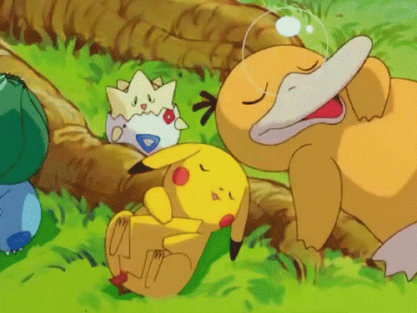
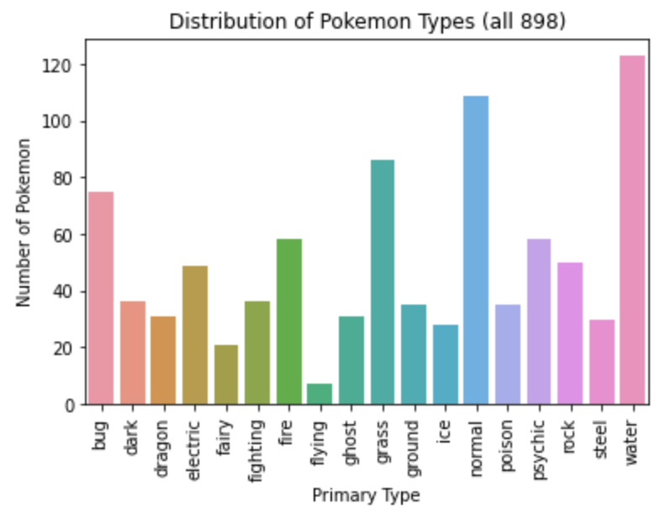
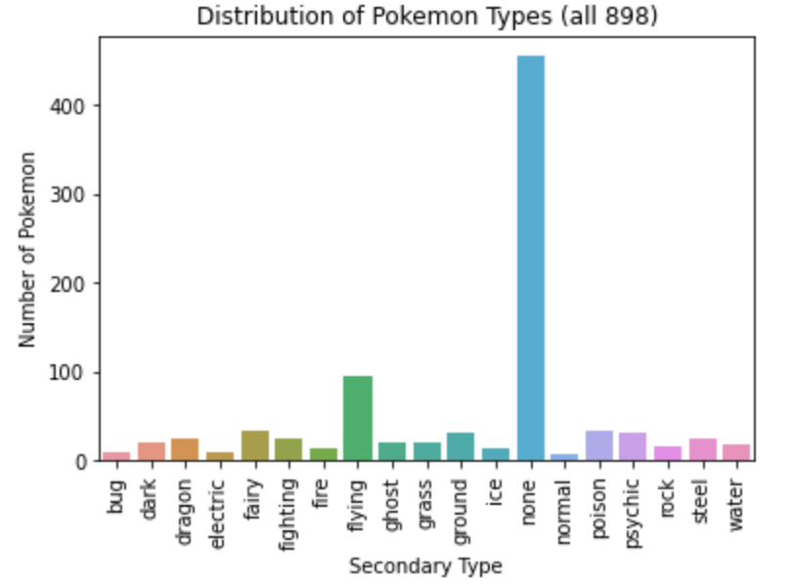
Pokemon Types - All Generations

Slide 5
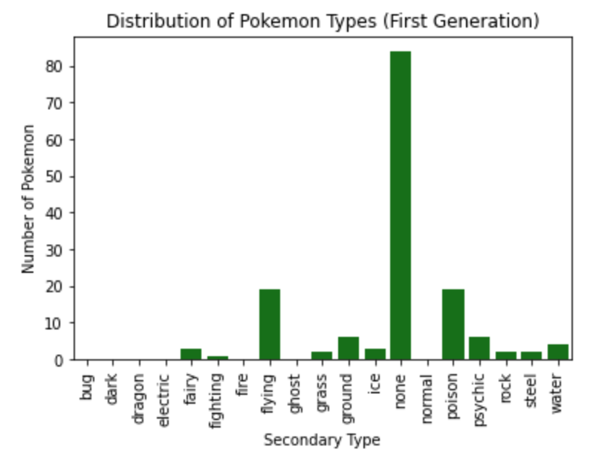
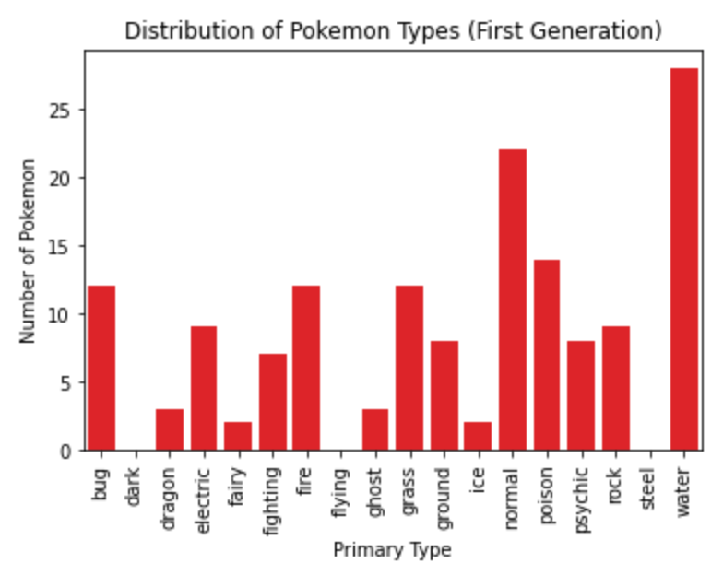
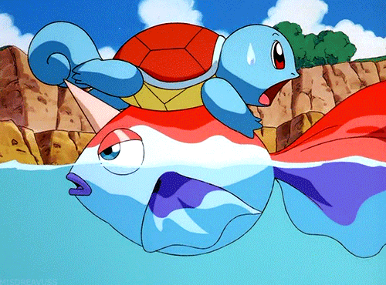
Pokemon Types - 1st Generation (Kanto region)

Slide 6
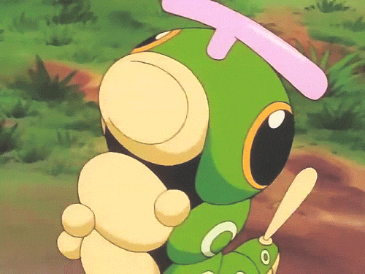
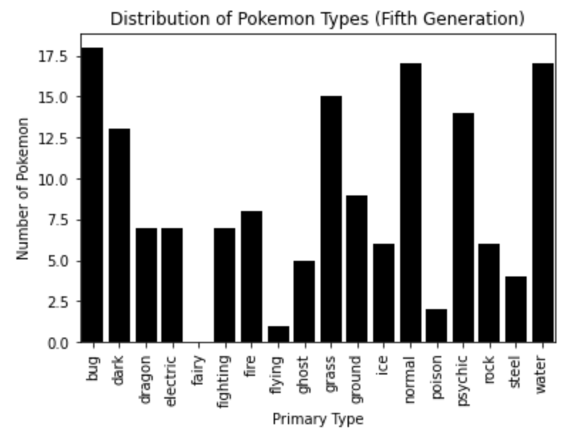
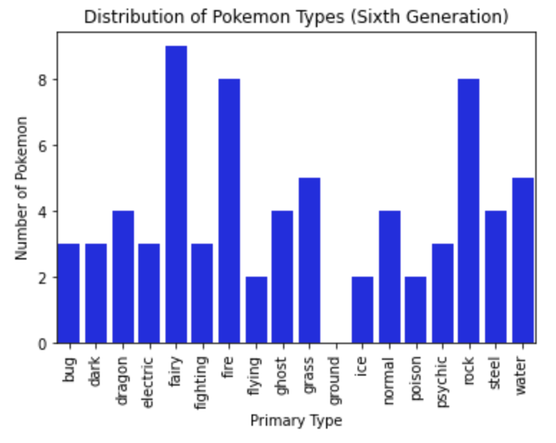
Pokemon Types - 5th and 6th Generations
(Unova and Kalos regions)

Slide 7
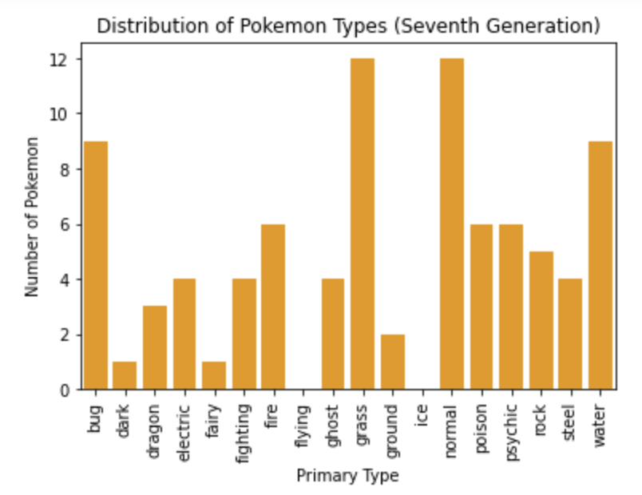
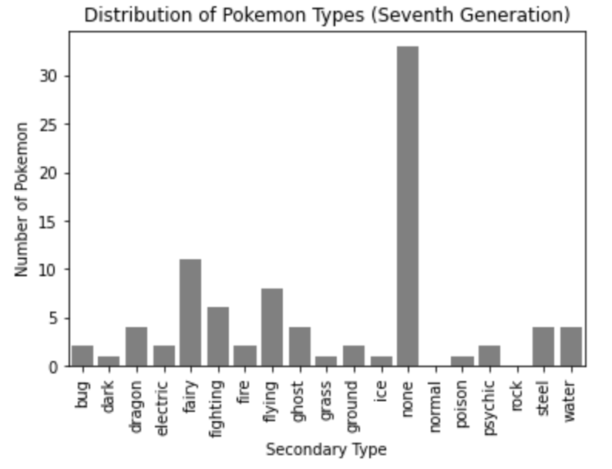

Pokemon Types - 7th Generation (Alola region)

Slide 8

What does the data show us?
Overall, the most common type is water, followed by normal, then grass
The least frequent types overall are flying and fairy
The majority of Pokemon have only one type, but for those that have a two types, the most common secondary type overall is flying.
The first few generations fall in line with these overall trends
Generational typing trends start diverging from the overall trends with Gen 4
Most common Gen 4 type = normal, followed by water and grass
Most common Gen 5 type = bug, followed by water and normal
Most common Gen 6 type = fairy, followed by fire and rock
… And Generations 7 and 8 diverge even more
Most common primary Gen 7 types = grass and normal
Most common secondary Gen 7 type = fairy
Most common primary Gen 8 types = electric and water
Most common secondary Gen 8 type = dragon

Slide 9
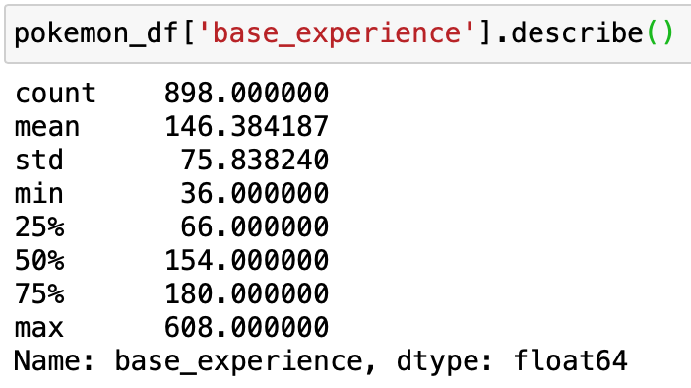
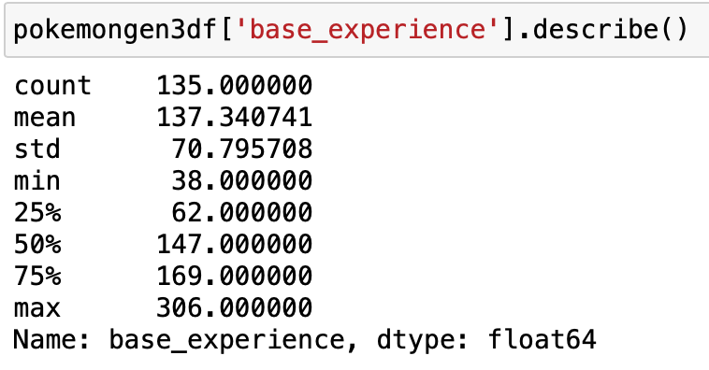
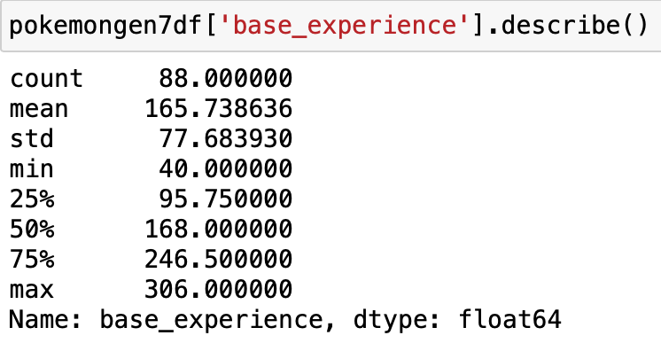
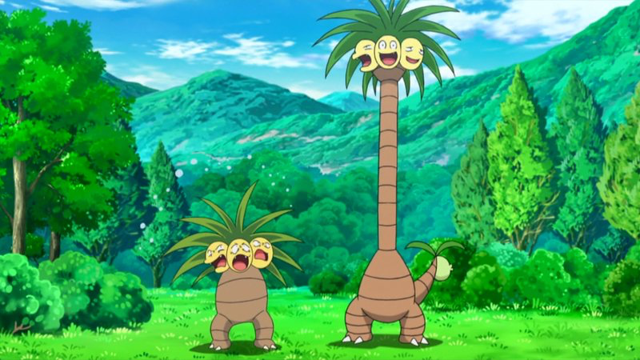
Generational Differences: Base Experience
3rd Gen = Hoenn region
Wide variety of habitats (mountains, deserts, etc.)
7th Gen = Alola region
Based on Hawaiian islands
Certain developed regional adaptations to the climate (ex. Alolan Exeggutor is super tall and skinny)
Notes:
Base experience may relate to region geography, maybe?

Slide 10
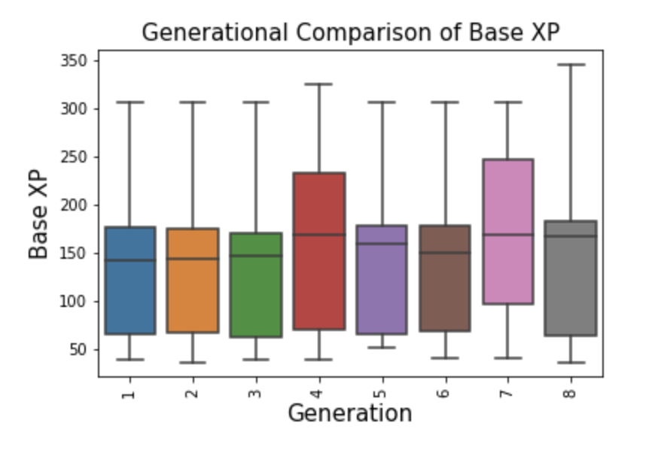
A visual representation of how base XP varies with generation
Gen. 4 & 8 stand out
Possible Gen. 5, 6, 8 are different but maybe not statistically so
Future work could include more detailed statistical analysis and pulling additional data to relate variations to in game factors such as habitat variability by region

Slide 11
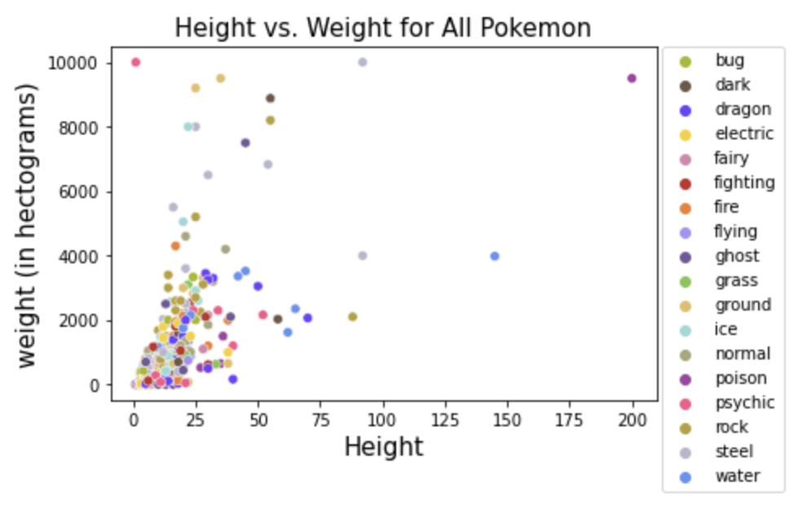
Investigating the relationships between various Pokemon attributes & stats:
Height vs. Weight
Weak positive correlation between Pokemon height and weight (r = 0.64)
One of the strongest correlations of the parameters we investigated

Slide 12
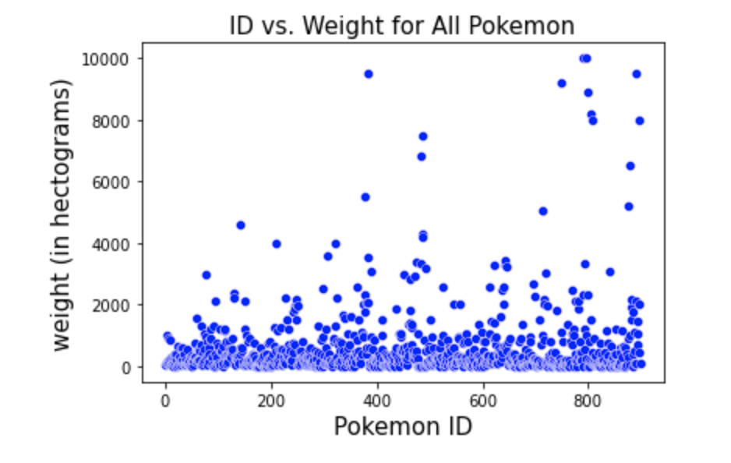
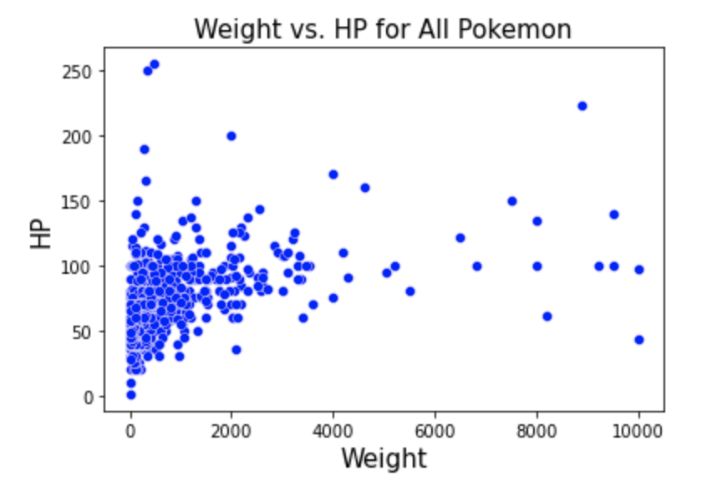
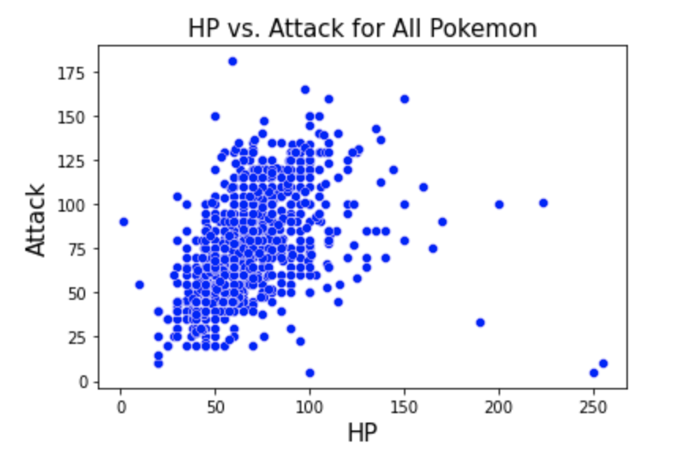
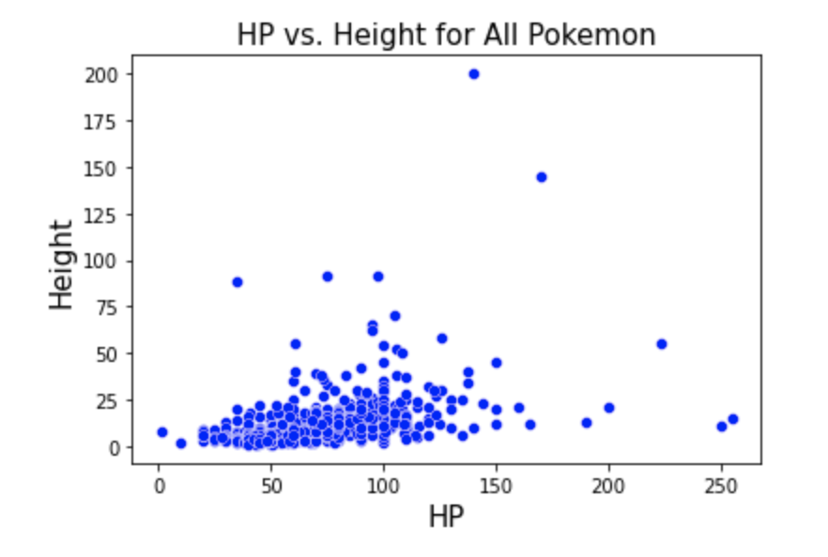
Investigating the relationships between various Pokemon attributes & stats:
A few representative examples

Slide 13
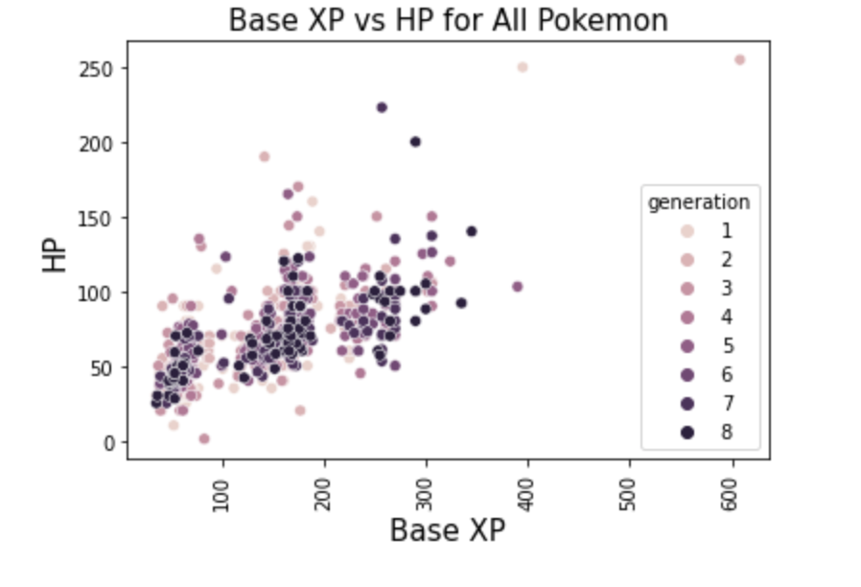
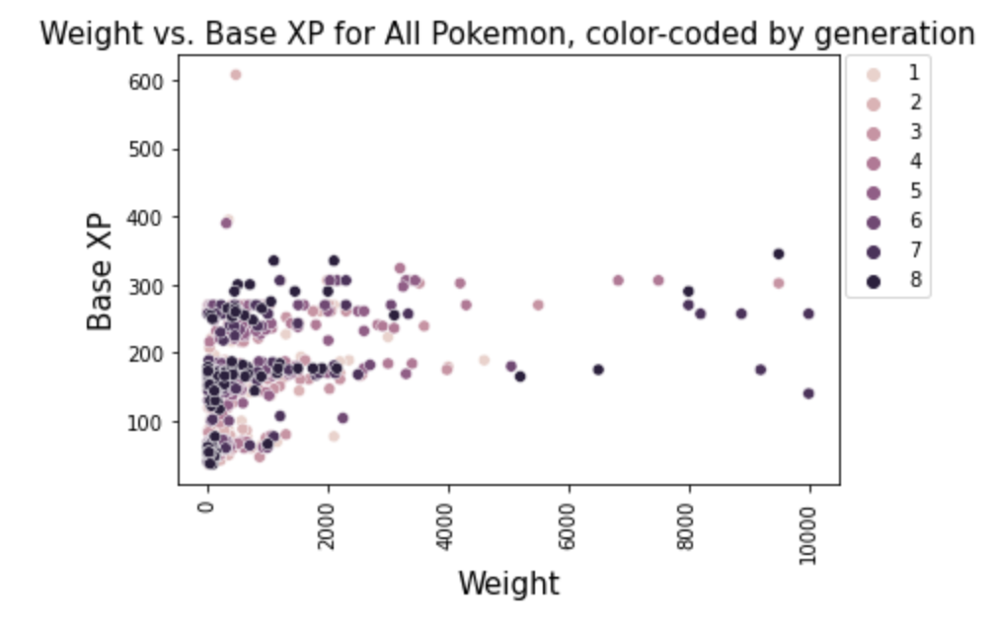
Investigating the relationships between various Pokemon attributes & stats:
Interesting patterns in Base XP

Slide 14
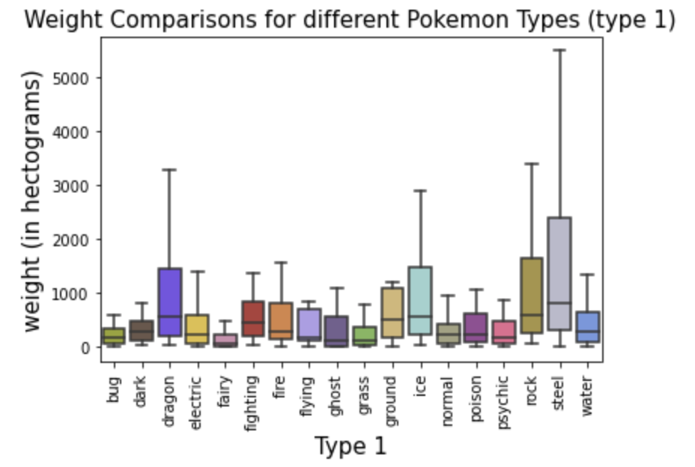
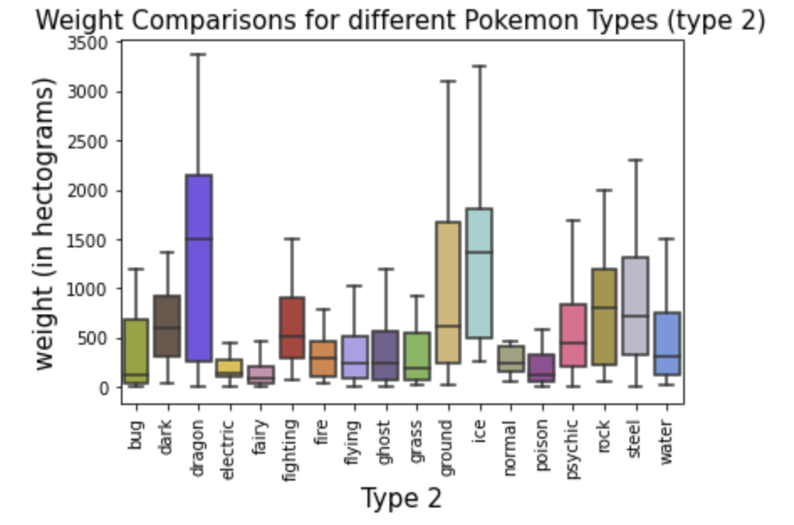
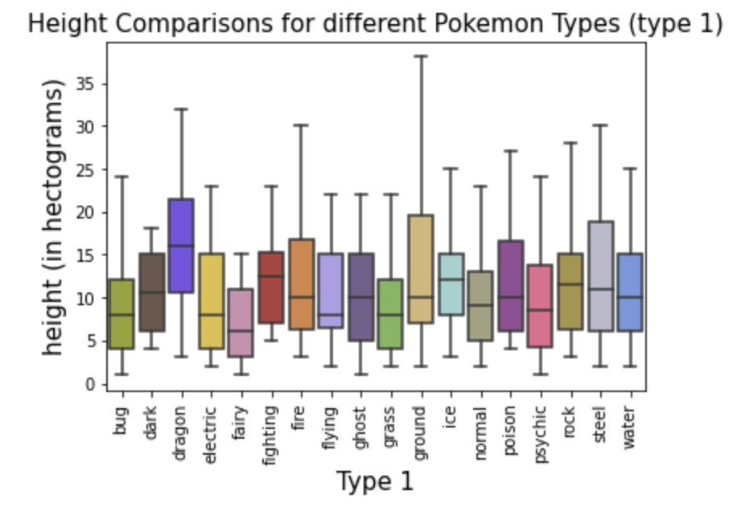
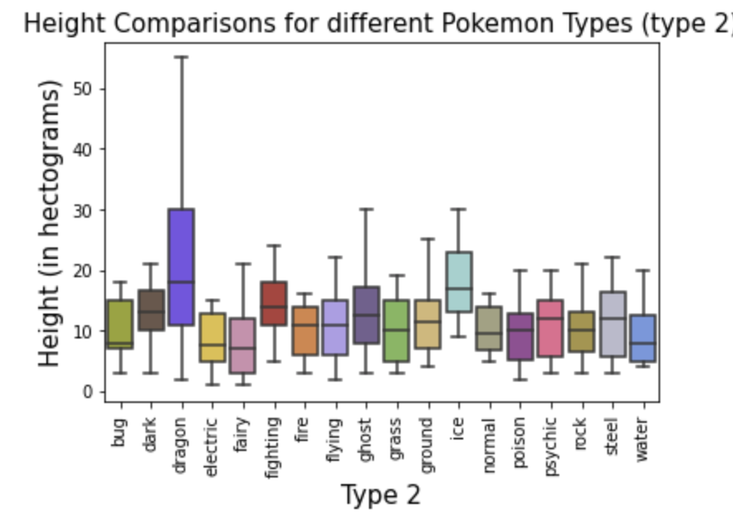
Does Pokemon type impact attributes (height, weight) and base statistics (hp, xp, attack, defense, etc)?

Slide 15
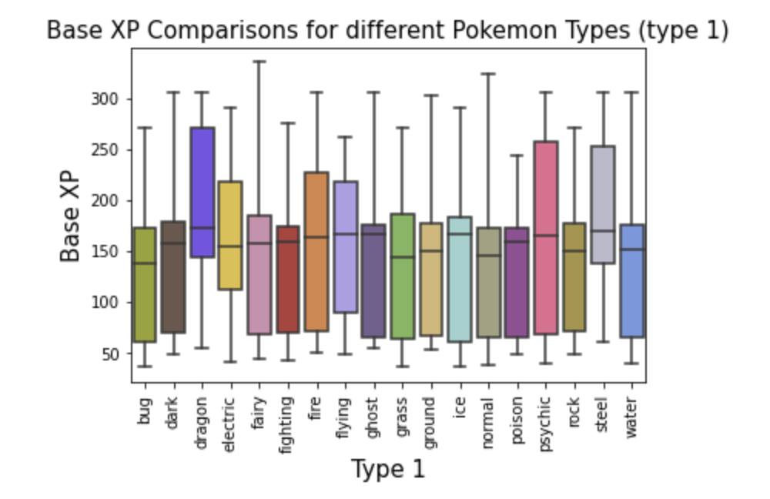
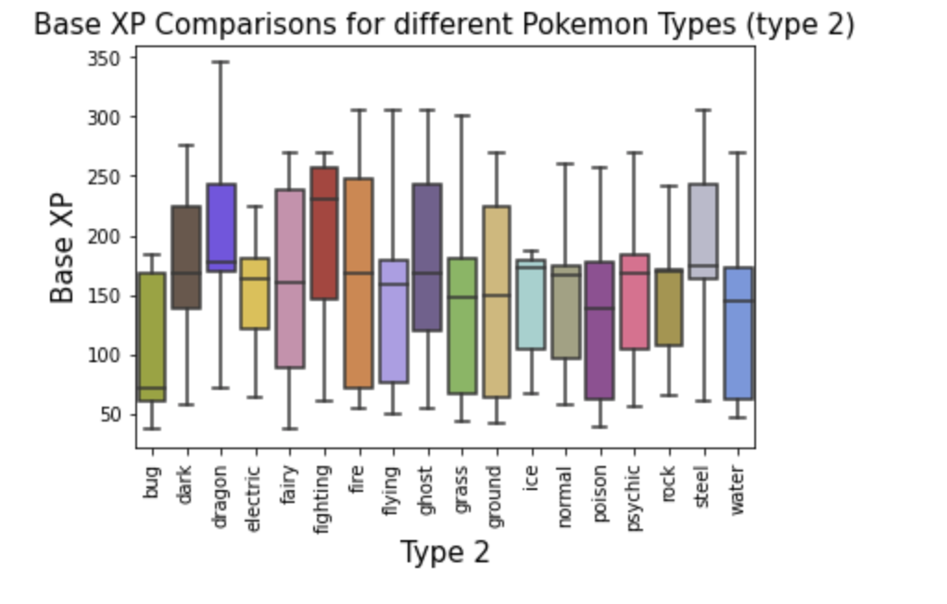
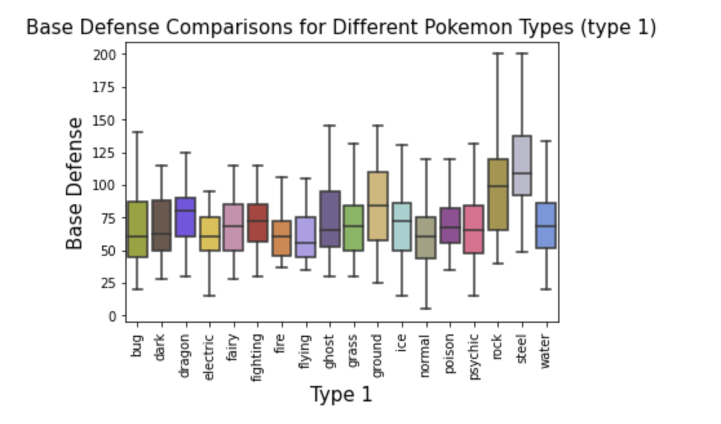
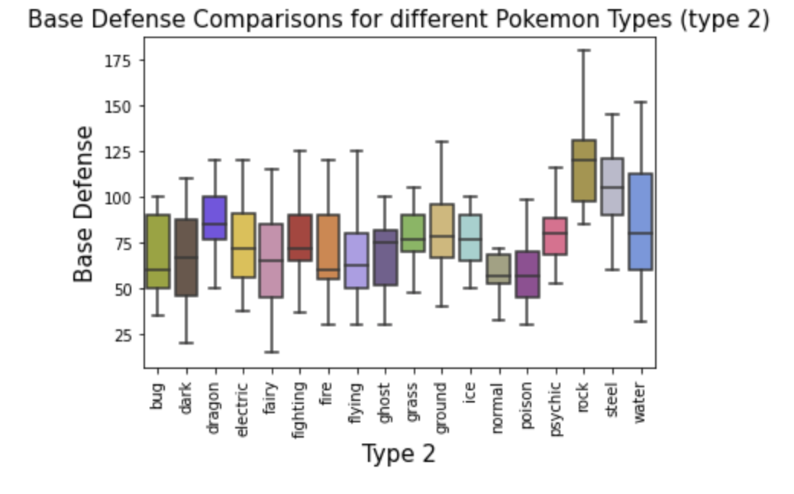
Does Pokemon type impact attributes (height, weight) and base statistics (hp, xp, attack, defense, etc)?

Slide 16
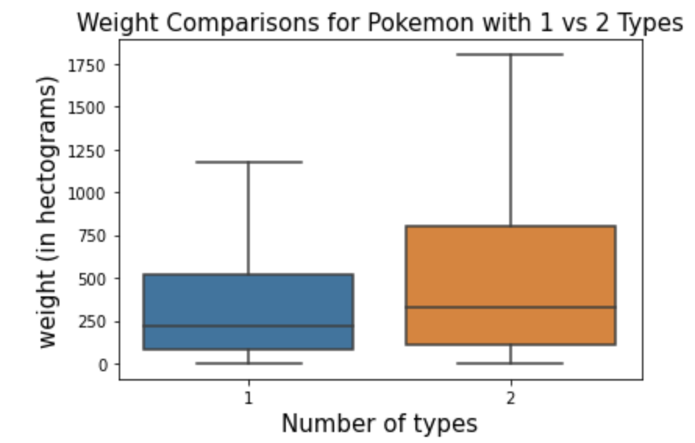
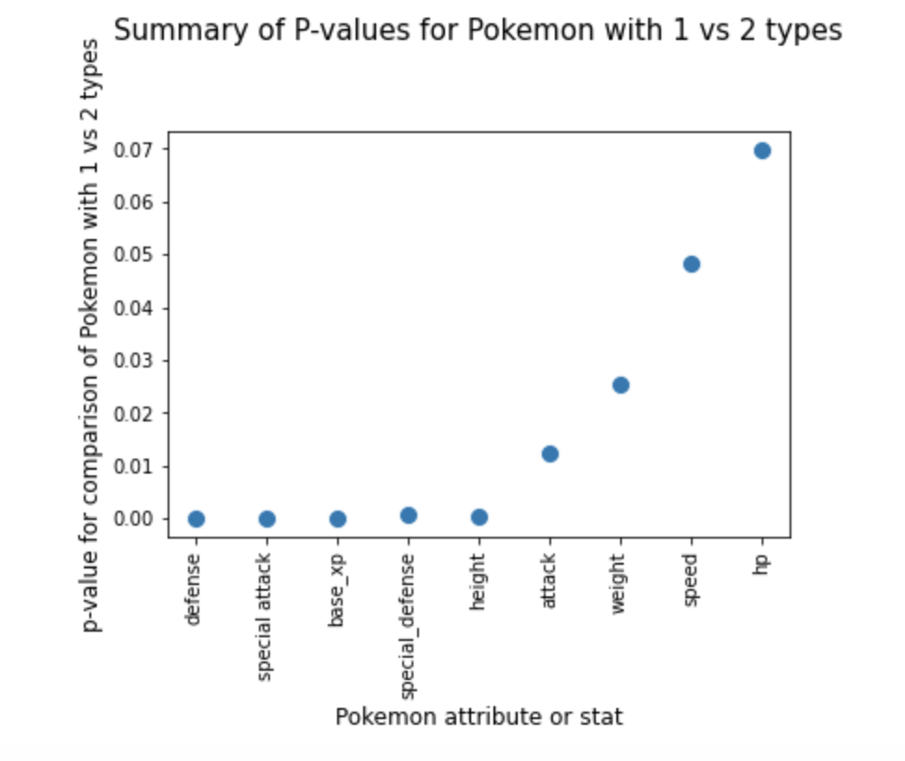
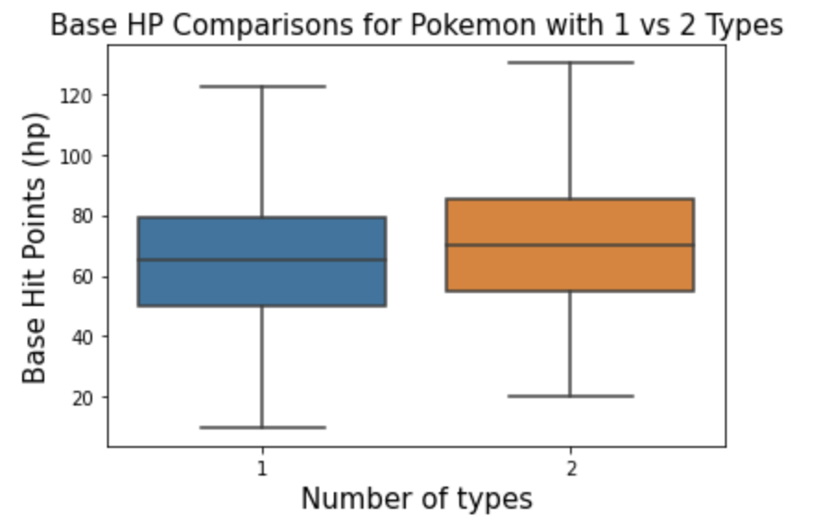
Does a Pokemon having 2 types have a base advantage over a Pokemon having only 1 type?
Yes...and maybe no

Slide 17

Summary, Conclusions and Hypothetical Next Steps
Type distributions vary by generation-artifact of environment?
There are also generational differences in base experience. Region/habitats?
There are some (fairly weak) positive correlations between Pokemon attributes.
Pokemon type impacts attributes and base stats. There are significant differences for some categories and for certain types (for example, rock and steel tend to diverge more from average Pokemon weight than other types) but not all types and parameters.
Pokemon with 2 types tend to be heavier, taller, have higher: base hp, xp, attack and defense. However, type advantage matters! Having 2 types may infer both advantages and disadvantages!
Some important factors not included (think evolutions, legendary and mythicals)-future research!
Sleepy Snorlax pic credit:https://www.walpaperlist.com/2020/01/pokemon-go-wallpaper-snorlax.html

